Slide 1
VITA Application Wire Frames
Volunteer and Site Coordinator App
Client App
Back Office Web

Slide 2
Volunteer And Site Coordinator

Slide 3
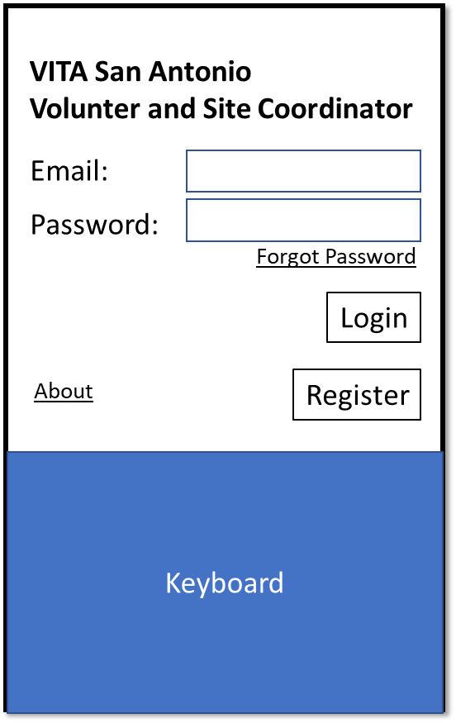
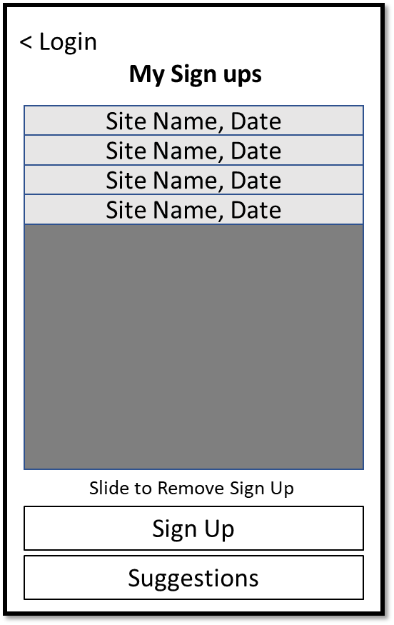
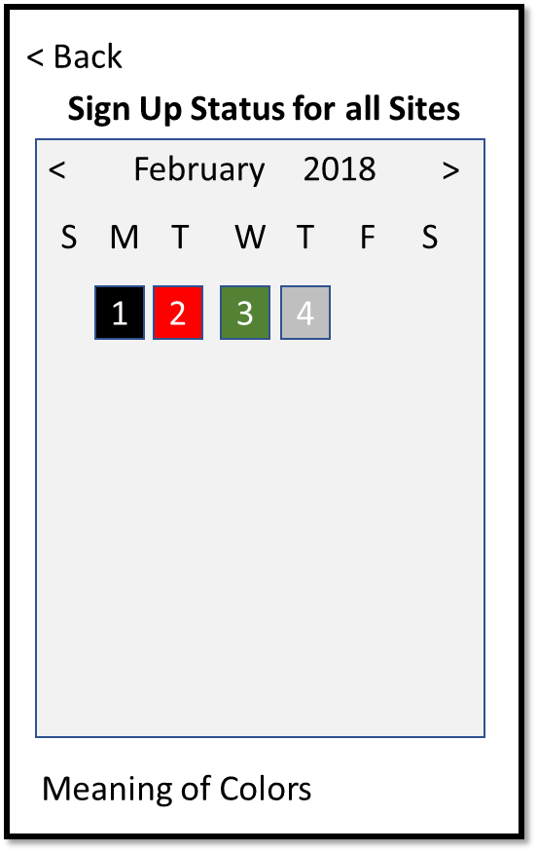
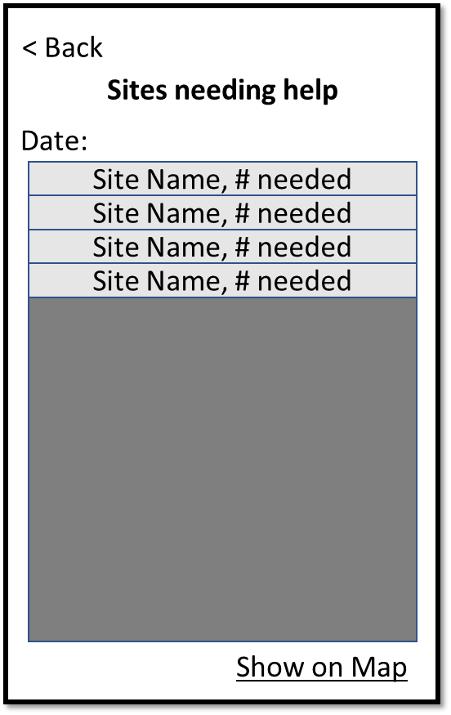
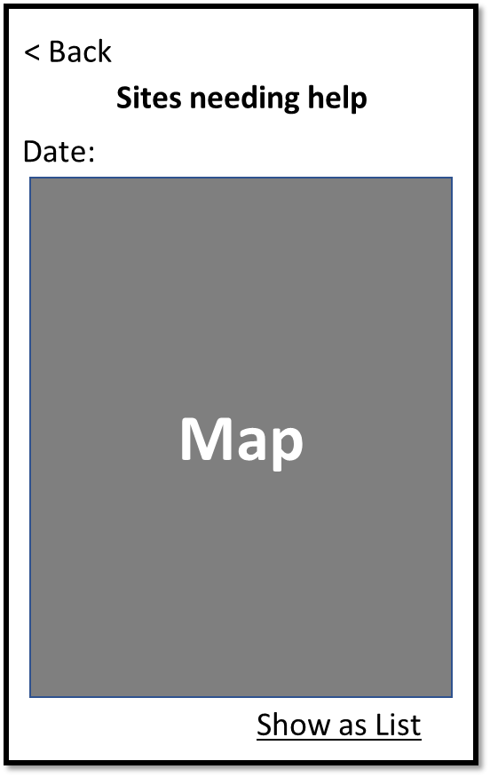
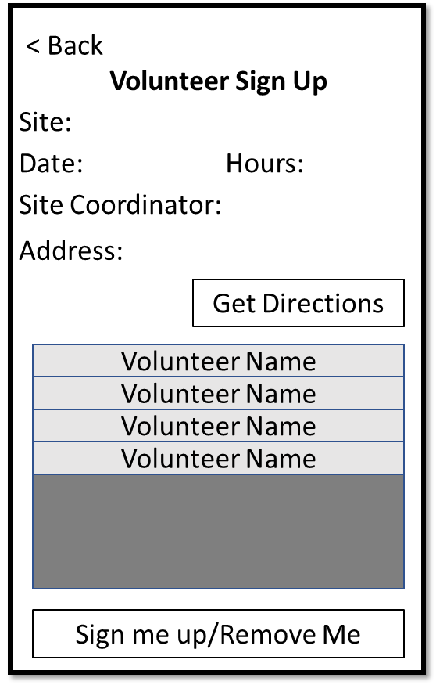
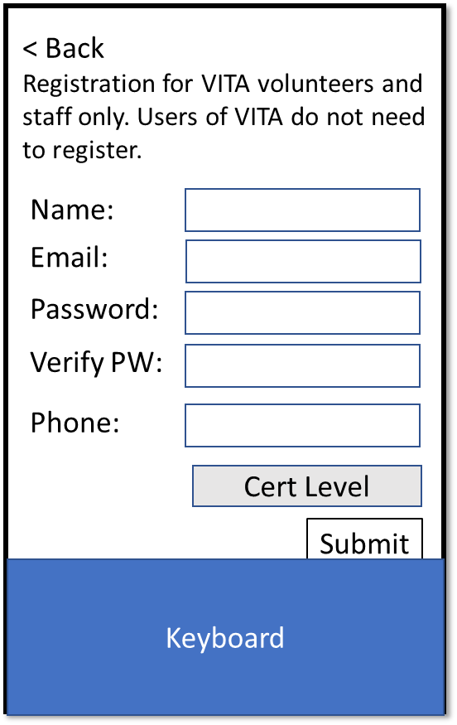
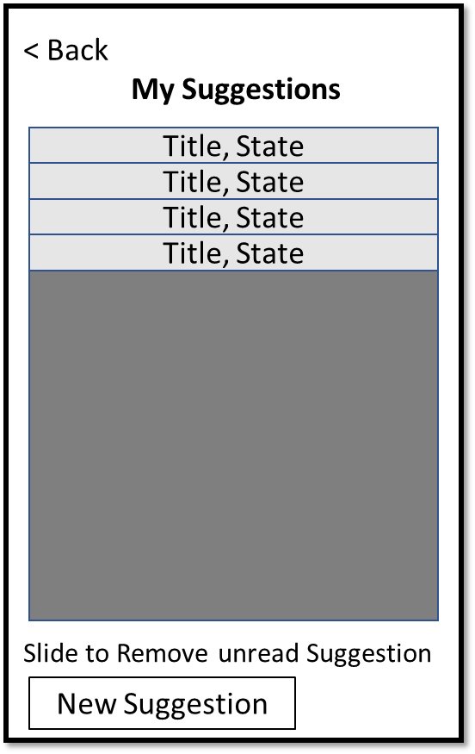
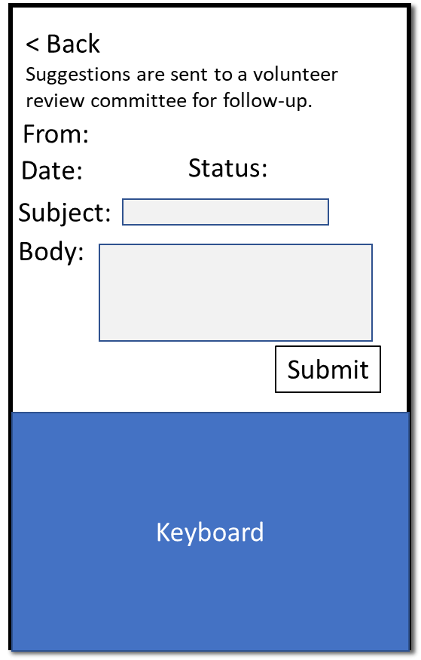
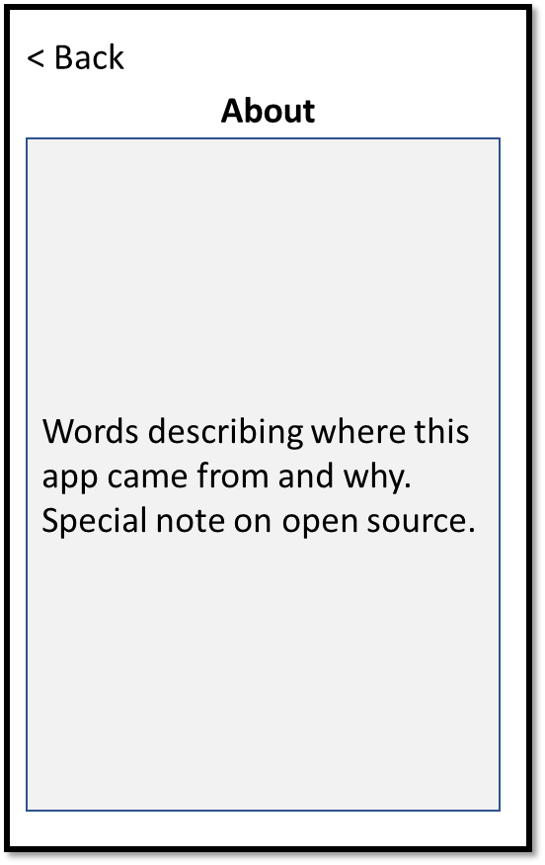
Volunteer and Site Coordinator App User Flow
Login
Vol MySignUps
Vol Cal
Vol SitesOnDateList
Vol SitesOnDateMap
Vol Sign Up
Register
Vol Suggestions
Vol Suggestion
About

Slide 4
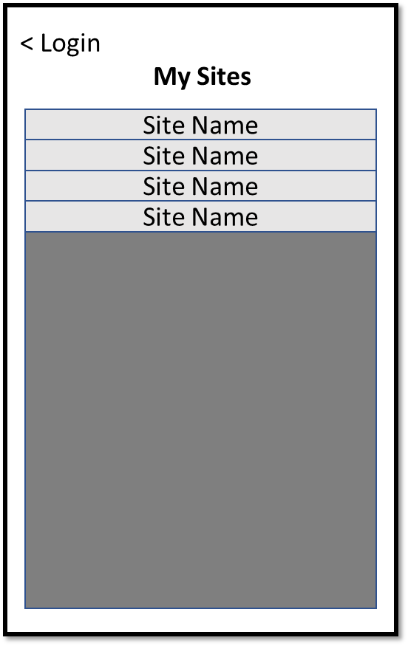
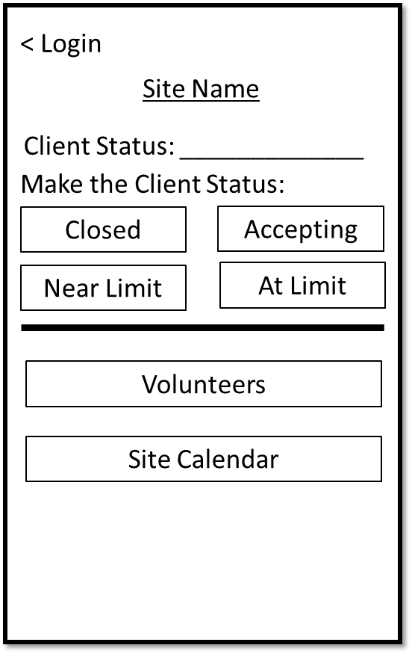
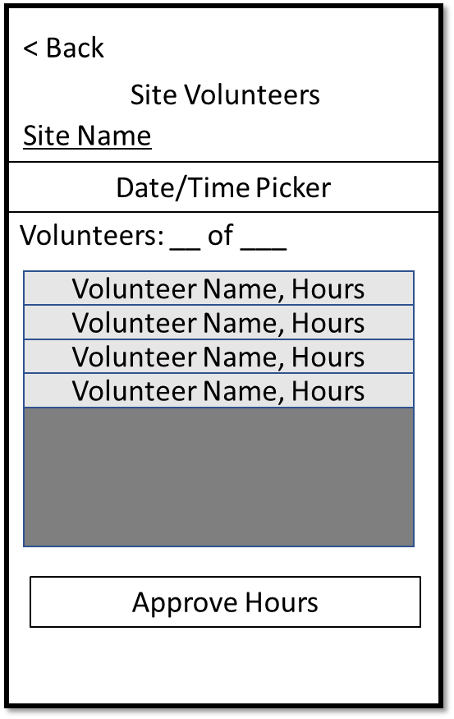
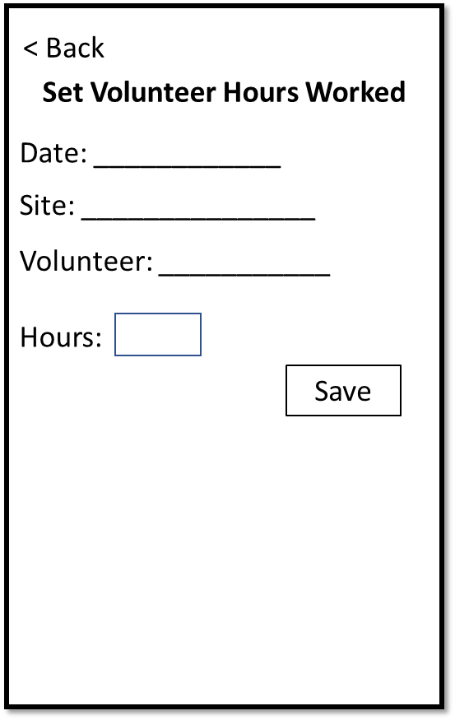
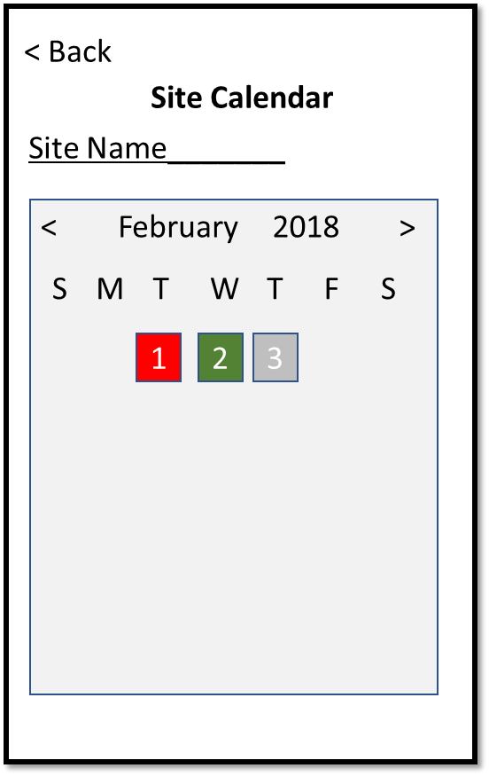
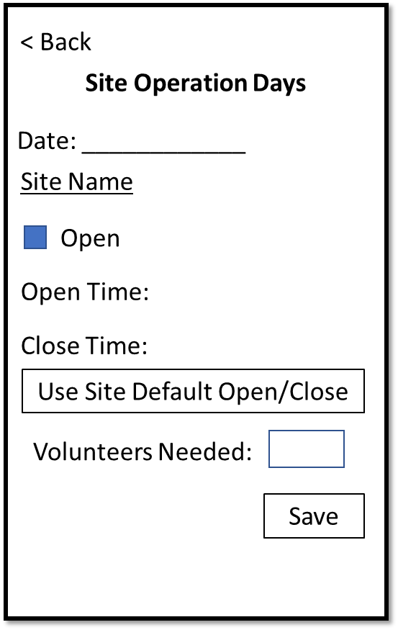
Volunteer and Site Coordinator App User Flow
Login
SC Sites
SC Site
Site Volunteers
SetVolHours
Register
Site Calendar
SiteOnDate

Slide 5
V_Login
If credentials already entered, ask for device authentication
If cred for Volunteer, then V_VAction
If cred for SC then
If SC for > 1 Sites: V_SCSites else V_SCSite
If no creds
B_Login -> validate, then use above for next screen
Login fail validate then Alert(bad creds)
B_Register -> V_Register
B_ForgotPassword -> ???
Alert box if offline
API
(#1.1) Login User(email, pw) -> User Role, Token
VITA San Antonio
Volunter and Site Coordinator
Email:
Password:
Forgot Password
Login
About
Register
Keyboard

Slide 6
V_Register
< Back
All field are required before the Submit button becomes active
Verify email looks like email
Password > 8 char, alpha and num
Phone has 10 digits
B_Submit
If already register, then Alert(already registered)
Alert: registration submitted, staff will activate; back to Login screen
B_Back -> V_Login
API
(#1.3) Register new user (details) -> status
Registration for VITA volunteers and staff only. Users of VITA do not need to register.
Name:
Email:
Password:
Verify PW:
Phone:
Cert Level
Submit
Keyboard

Slide 7
V_VMySignUps
B_Login -> V_Login
Show list of dates and places I’ve signed up
Show all sign ups including dates in the past
For past dates, show hours work if approved
For today and future:
Tap -> V_VSignUp
Slide to show Remove
B_SignUp -> V_Vcalendar
B_Suggestions -> V_Vsuggestions
API
(#2.1) Get SignUps for User
(#2.3) Remove SignUp for User
< Login
My Sign ups
Site Name, Date
Site Name, Date
Site Name, Date
Site Name, Date
Slide to Remove Sign Up
Sign Up
Suggestions

Slide 8
V_VCalendar
B_Back to V_VMySignUps
Show grid calendar
Each date:
Gray if all Sites are closed
Red if any Site open and has needs
Green if ALL Sites are happy
Black: dates I’ve signed up
Tap on Date
If Black -> V_VSignUp
If Red -> V_VSitesOnDate
Else ignore
API
(#2.1) Get Site SignUps for all Sites for Date Range
(#3.1) Get Site Calendar for Date Range
< Back
Sign Up Status for all Sites
<
February
2018
>
S
M
T
W
T
F
S
1
2
3
4
Meaning of Colors

Slide 9
V_VSitesOnDateList
< Back
B_Back to V_VCalendar
Show list of all open Sites on this date
Show Site Name and number needed
Tap on Site -> V_VSignUp
API
(gets the data from the previous screen, held in global)
Sites needing help
Date:
Site Name, # needed
Site Name, # needed
Site Name, # needed
Site Name, # needed
Show on Map

Slide 10
V_VSitesOnDateMap
< Back
B_Back to V_VCalendar
Show map of all open Sites on this date
Tap on Site -> V_VSignUp
API
(data from previous screen)
Sites needing help
Date:
Map
Show as List

Slide 11
V_VSignUp
B_Back to previous screen (save in global)
Show Site details on date
Show list of sign-ups for that date for all Users
If User is in the list, button is Remove Me
If User is not in the list, button is Sign Me Up
B_GetDirections -> native maps app with destination address
Button tap -> V_VMySignUps
For past dates: view only (no remove, no sign me up button)
API
(#2.1) Get SignUps for User at Site on Date
(#2.2) Add SignUp for User at Site on Date
(#2.3) Remove SignUp for User at Site on Date
< Back
Volunteer Sign Up
Site:
Date:
Hours:
Site Coordinator:
Address:
Get Directions
Volunteer Name
Volunteer Name
Volunteer Name
Volunteer Name
Sign me up/Remove Me

Slide 12
V_VSuggestions
< Back
B_Back to V_VSignUps
Show list of all Suggestions for this user
Tap on Suggestion ->V_Vsuggestion (view but not edit)
B_New -> V_Vsuggestion (create new, can edit)
Slide Suggestion to show Delete; use Alert to confirm Delete; can only delete if in status of not closed/acted on
API
(#5.1) Get suggestions for User
(#5.3) Remove suggestion for User
My Suggestions
Title, State
Title, State
Title, State
Title, State
Slide to Remove unread Suggestion
New Suggestion

Slide 13
V_VSuggestion
< Back
B_Back to V_VSuggestions
Show details for this suggestion
From and Date are labels
If existing, then show but cannot edit, B_Submit is disabled
Otherwise can edit
Post to DB if Submit if new with fields completed
API
(#5.2) Add Suggestion for User
(#5.4) Update Suggestion for User
< Back
My Suggestions:
Suggestions are sent to a volunteer review committee for follow-up.
From:
Date:
Status:
Subject:
Body:
Submit
Keyboard

Slide 14
V_SCSites
< Login
B_Login -> V_Login
We are only here because this User is a Site Coordinator with multiple Sites
Show a list of all Sites for this User as SC
Tap -> V_SCSite
API
(#11) Get Sites for User/Site Coordinator
My Sites
Site Name
Site Name
Site Name
Site Name

Slide 15
V_SCSite
< Login
B_Login -> V_Login or V_SCSites if multi-site coordinator
Client Status: show current setting for the Site
Grey out the current status setting
Tap new status -> change Site status, change labels and grayed buttons
Tap VolunteerS -> V_SCVEdit
Tap Calendar -> V_SCCalendar
API
(#4.1) Get Client Status for Site
(#4.2) Set Client Status for Site
Site Name
Client Status: _____________
Make the Client Status:
Closed
Accepting
Near Limit
At Limit
Volunteers
Site Calendar

Slide 16
V_SCSiteVolunteers
< Back
B_Back -> V_SCSite
Show number of Volunteers for selected date out of target
Tap Volunteer -> V_SCSetVolHours
Tap Approve Hours -> Alert to confirm, then show volunteer hours as locked
Pull down on Volunteer list to refresh (to cover case where Volunteer was not on the list, Vol added himself, now need to see to approve)
API
(#2.1) Get SignUps for Site on Date
(#2.5) Show Volunteers Hours Approved
(#4.1) Get Site Details (has seats required)
Site Volunteers
Site Name
Date/Time Picker
Volunteers: __ of ___
Volunteer Name, Hours
Volunteer Name, Hours
Volunteer Name, Hours
Volunteer Name, Hours
Approve Hours

Slide 17
V_SiteCalendar
< Back
B_Back to V_SCSite
Show grid calendar (?)
Each date: Gray if closed, Red if have needs, Green if no needs
Values are for this Site only
Tap on Date -> V_SiteOnDate
API
(#3.1) Get Calendar for Site in Date Range
(#2.1) Get SignUps for Site in Date Range
Site Calendar
Site Name_______
<
February
2018
>
S
M
T
W
T
F
S
1
2
3

Slide 18
V_SiteOnDate
< Back
B_Back to V_SiteCalendar (save changes on exit)
Check Box for Site open on that date
Show date and Site name
Open/Close time/button disabled if closed
Show open/Close times if open
Show current volunteer numbers
B_Save -> V_SiteCalendar
API
(#3.1) Get Site Calendar for Site on Date
(#4.1) Get Site Details (for defaults)
(#3.2) Set Site Calendar for Site on Date
Site Operation Days
Date: ____________
Site Name
Open
Open Time:
Close Time:
Use Site Default Open/Close
Volunteers Needed:
Save

Slide 19
V_SCSetVolHours
< Back
B_Back -> V_VSCSite
Show: date, Site, Volunteer name for this entry
Show hours worked
B_Save -> save hours worked, -> V_SCSite
API
(get volunteer data from previous screen)
(#2.4) Update SignUp for User on Site at Date
Set Volunteer Hours Worked
Date: ____________
Site: _______________
Volunteer: ___________
Hours:
Save

Slide 20
V_About
< Back
About
B_Back -> Home
Show predefined text
API
none
Words describing where this app came from and why. Special note on open source.

Slide 21
Client

Slide 22
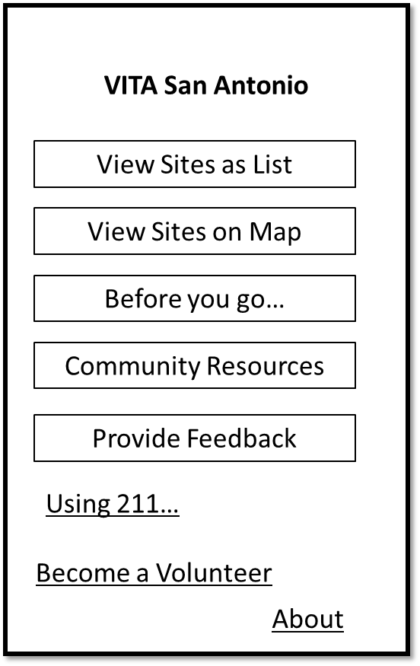
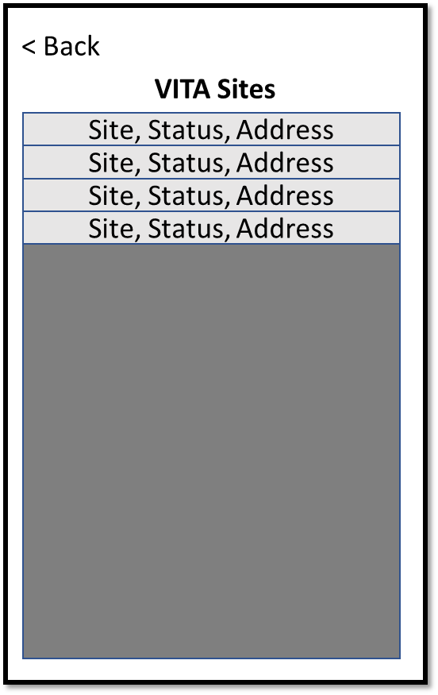
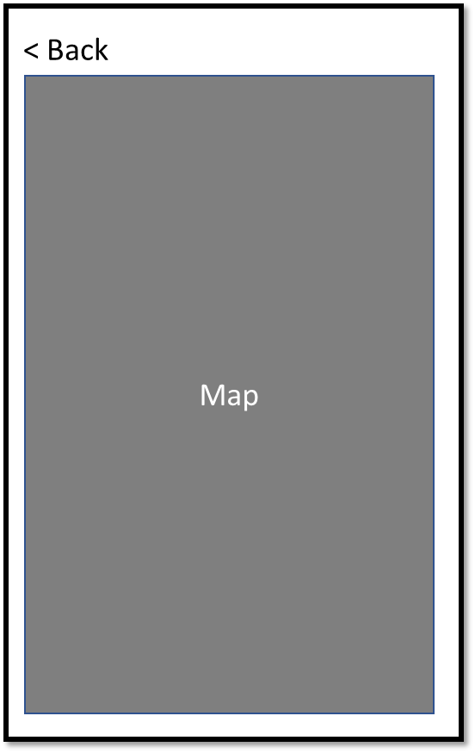
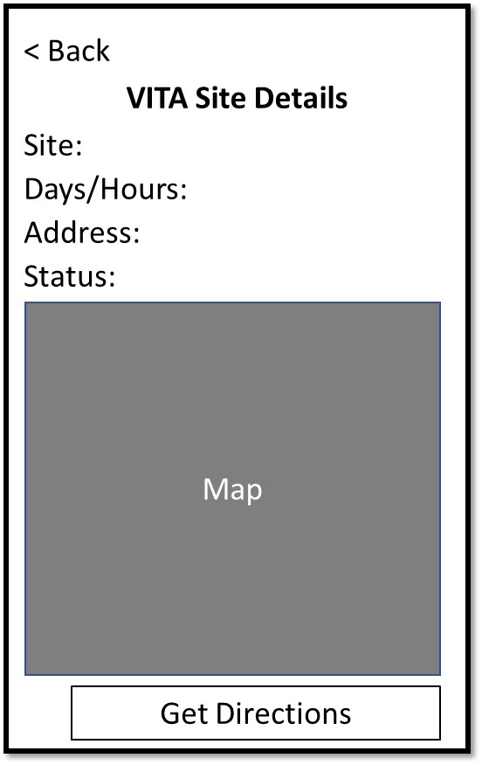
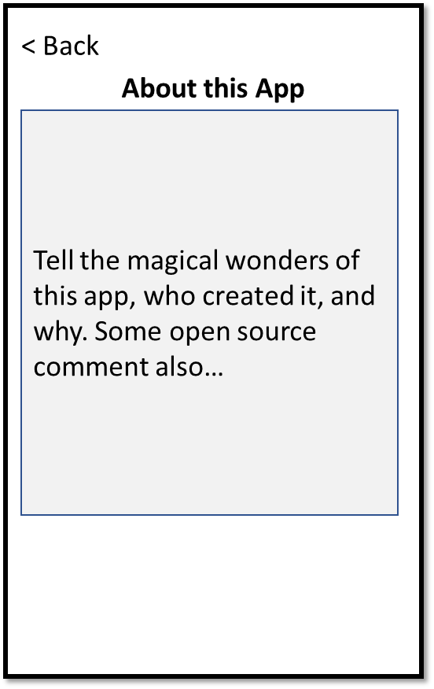
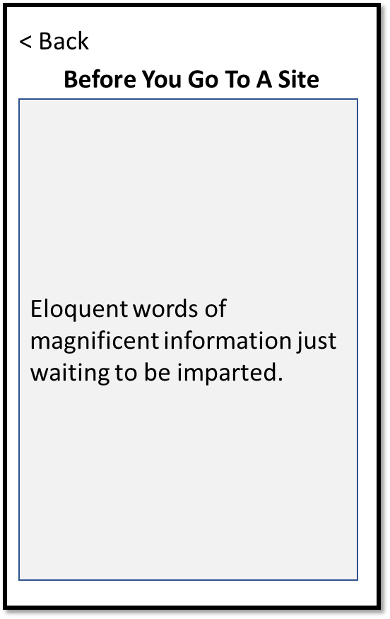
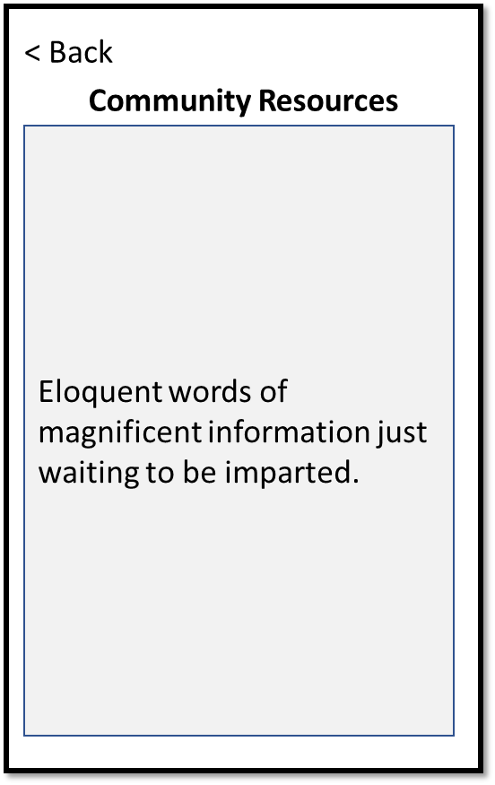
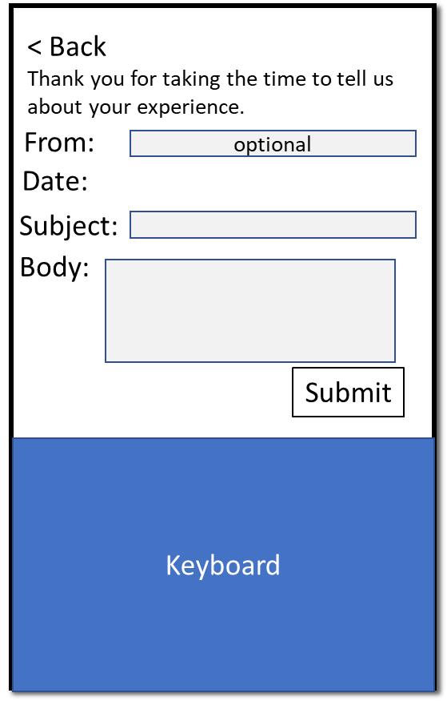
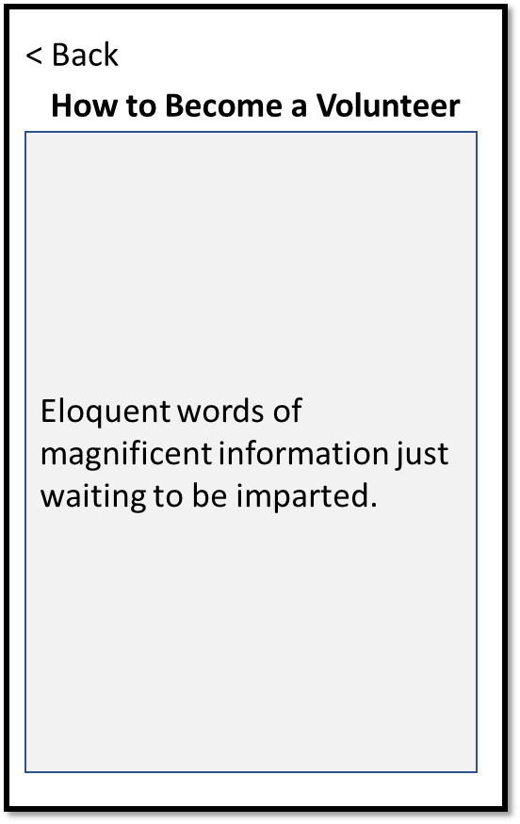
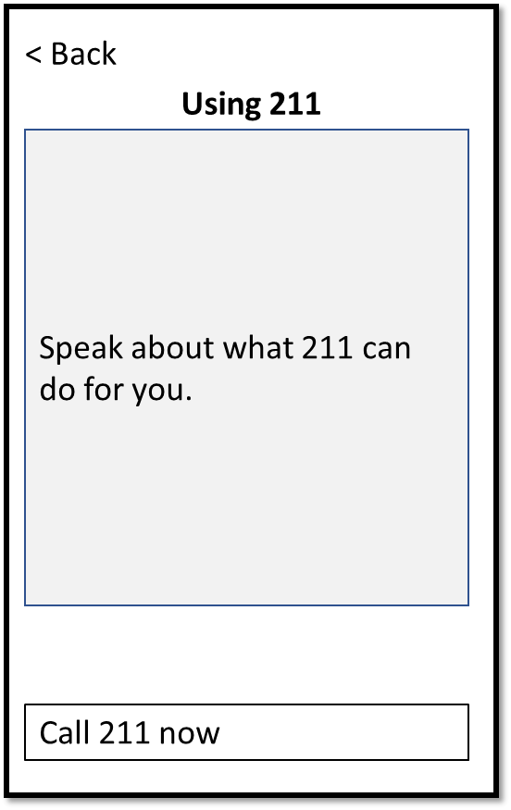
Client App Screens

Slide 23
Home
VITA San Antonio
Opening Screen
View Sites as List
View Sites on Map
Before you go…
Community Resources
Provide Feedback
Using 211…
Become a Volunteer
About

Slide 24
V_SiteList
< Back
VITA Sites
B_Back -> Home
Show list of all Sites
Tap on Site -> V_SiteDetails
API
(#4.1) Get all Site Details
Site, Status, Address
Site, Status, Address
Site, Status, Address
Site, Status, Address

Slide 25
V_SiteMap
< Back
Map
B_Back -> Home
Show list of all Sites
Tap on Site -> V_SiteDetails
API
(#4.1) Get all Site Details

Slide 26
V_SiteDetails
< Back
VITA Site Details
B_Back -> referrer
Show Site details
B_Directions -> vendor maps
API
(#4.1) Get Site Details
Site:
Date/Hours:
Address:
Status:
Map
Get Directions

Slide 27
V_BeforeYouGo
< Back
Before You Go To A Site
B_Back -> Home
Show predefined text
API
(#7.1) Get Message(beforeYouGo, language)
Eloquent words of magnificent information just waiting to be imparted.

Slide 28
V_CommunityResources
< Back
Community Resources
B_Back -> Home
Show predefined text
API
(#7.1) Get Message(communityResources, language)
Eloquent words of magnificent information just waiting to be imparted.

Slide 29
V_ProvideFeedback
< Back
B_Back -> Home
Allow user to fill in the fields
From: is optional
Post to DB if fields contain text
After Post: Alert: Thank You!
API
(#5.2) Add Suggestion (unauthenticated)
< Back
My Suggestions:
Thank you for taking the time to tell us about your experience.
From:
optional
Date:
Subject:
Body:
Submit
Keyboard

Slide 30
V_BecomeAVolunteer
< Back
How to Become a Volunteer
B_Back -> Home
API
(#7.1) Get Message(becomeAVolunteer, language)
Eloquent words of magnificent information just waiting to be imparted.

Slide 31
V_Using211
< Back
Using 211
B_Back -> Home
API
(#7.1) Get Message(using211, language)
Speak about what 211 can do for you.
Call 211 now

Slide 32
V_About
< Back
About this App
B_Back -> Home
Show predefined text (language)
API
none
Tell the magical wonders of this app, who created it, and why. Some open source comment also…

Slide 33
Back Office Web

Slide 34
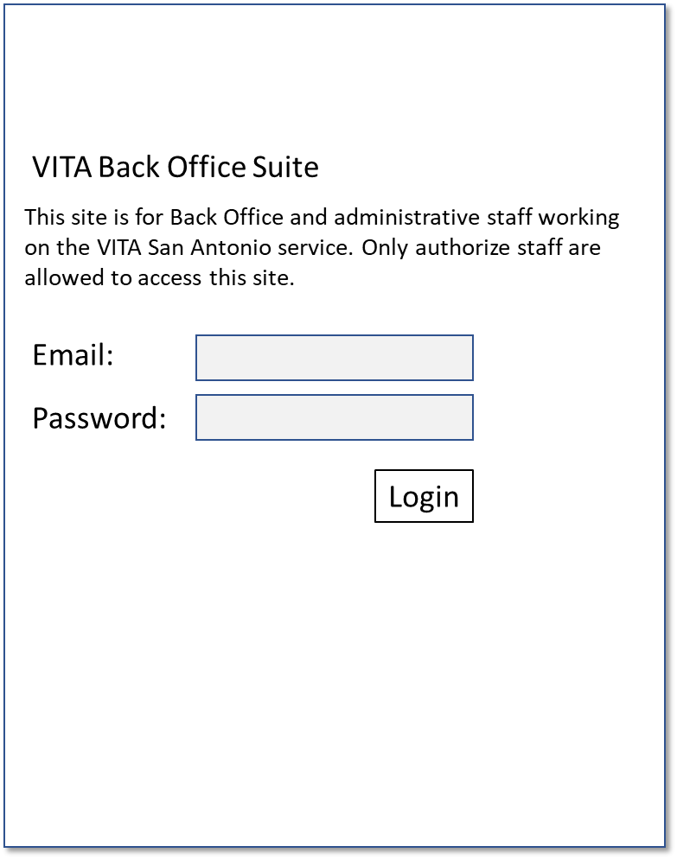
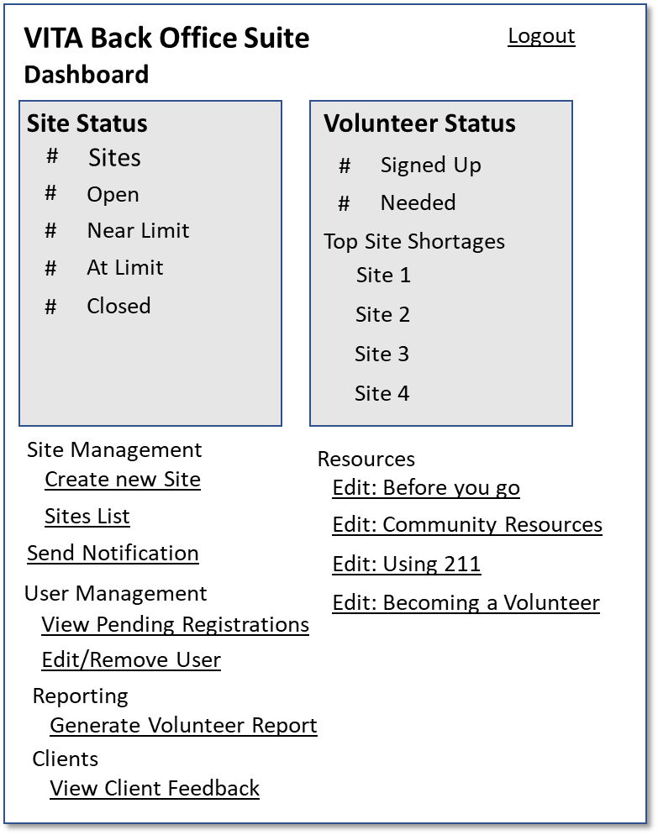
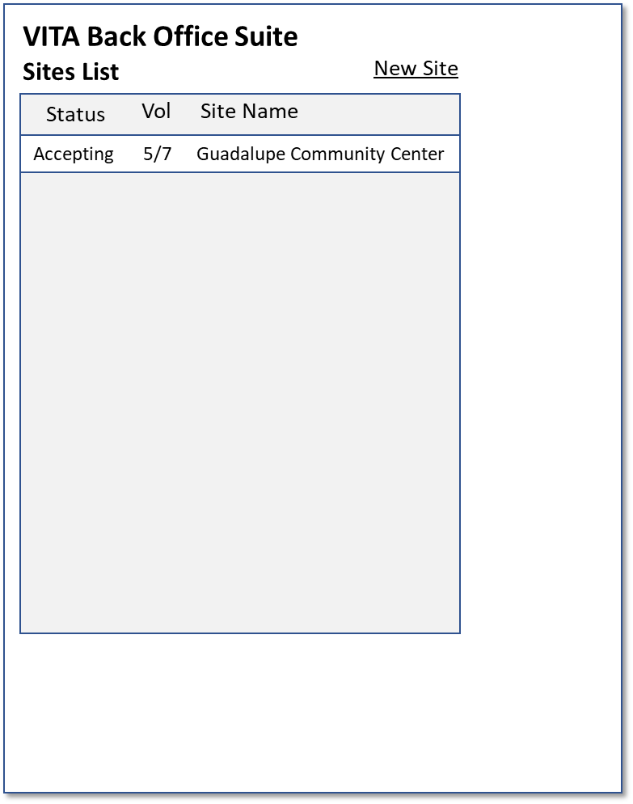
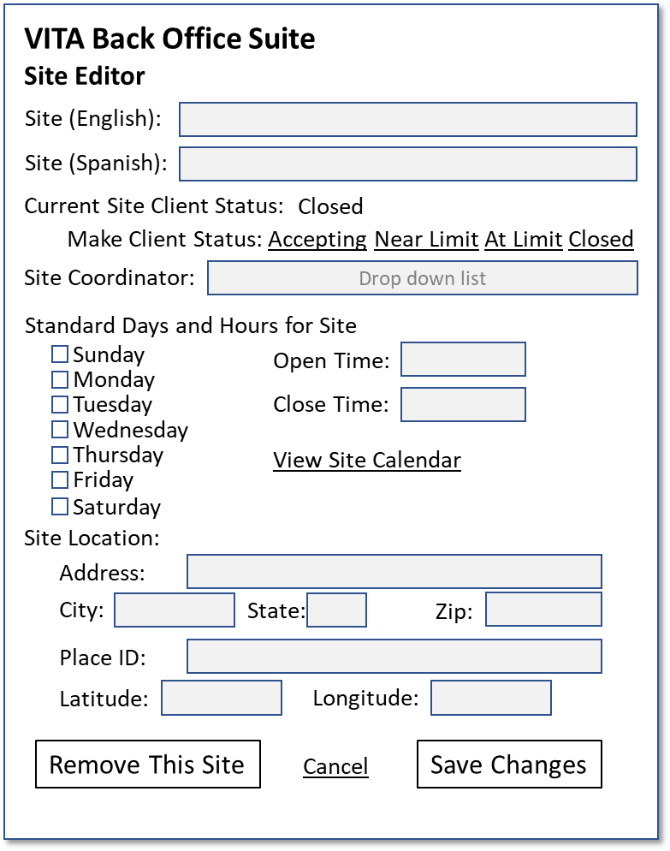
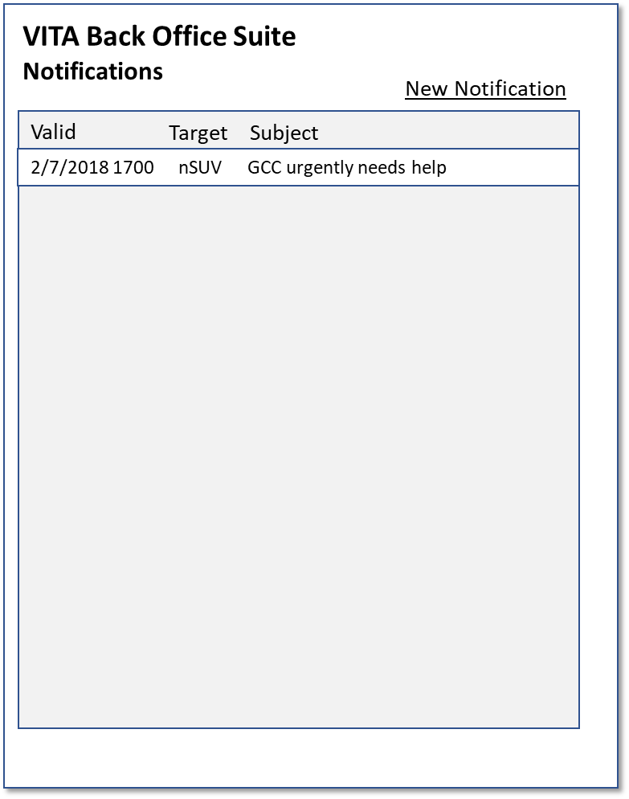
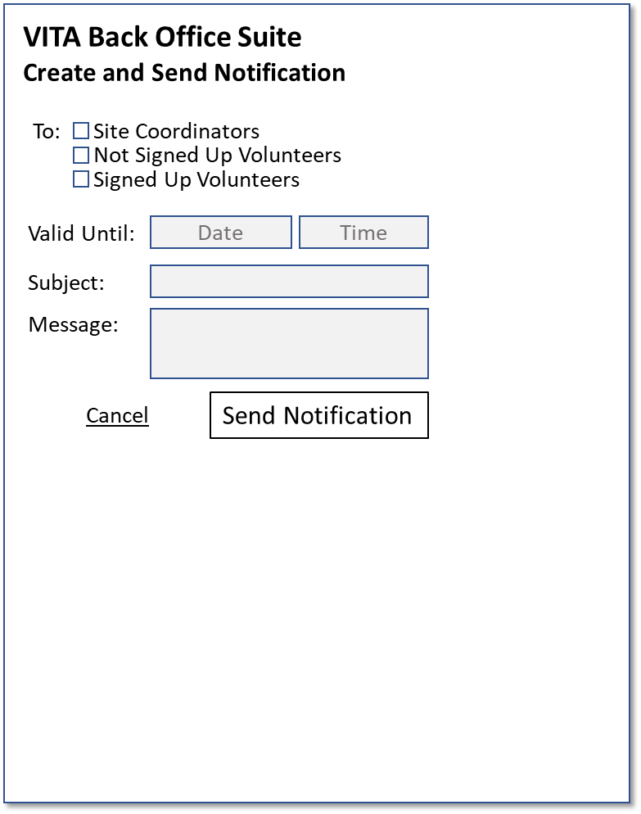
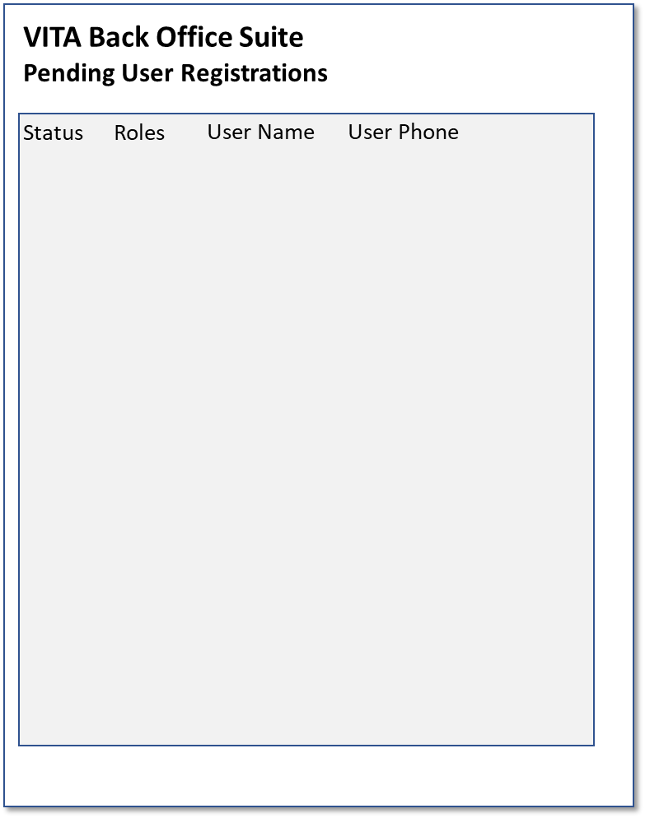
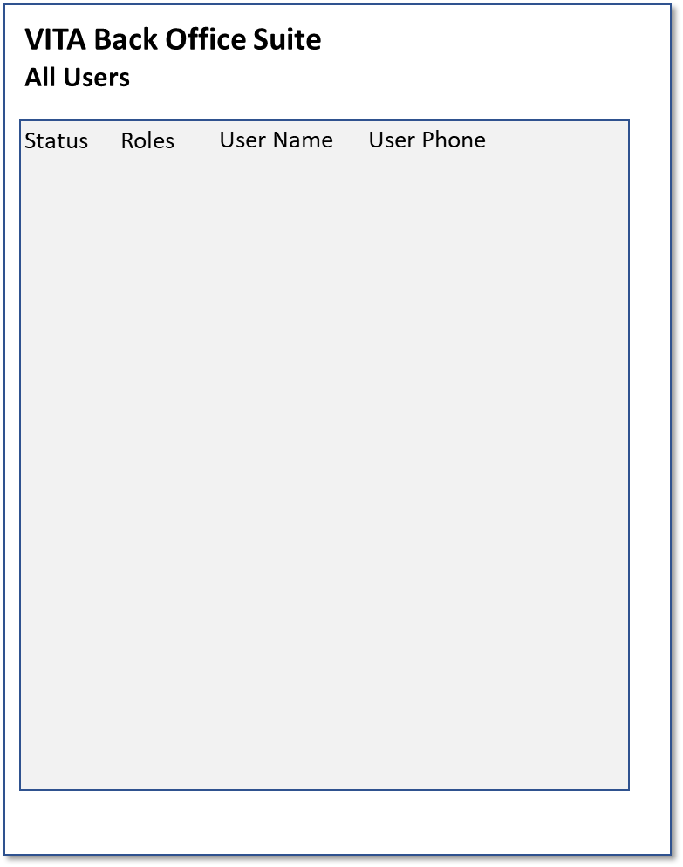
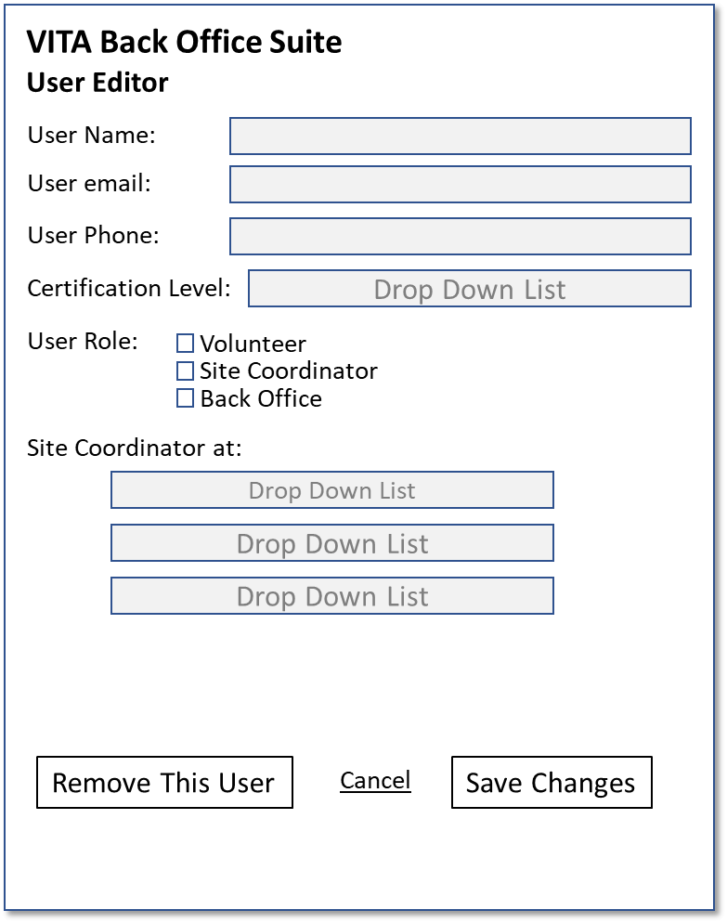
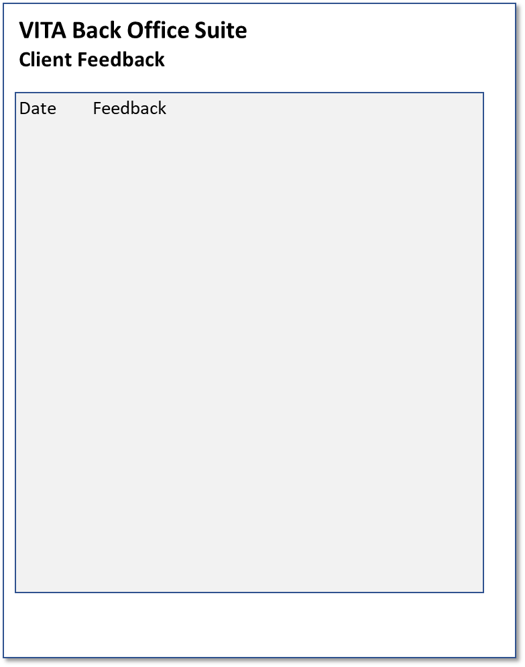
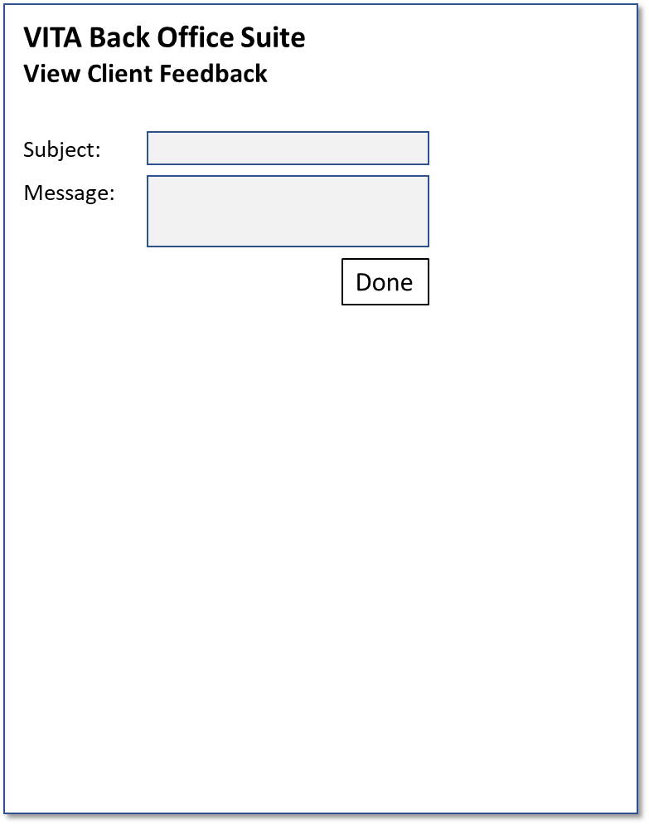
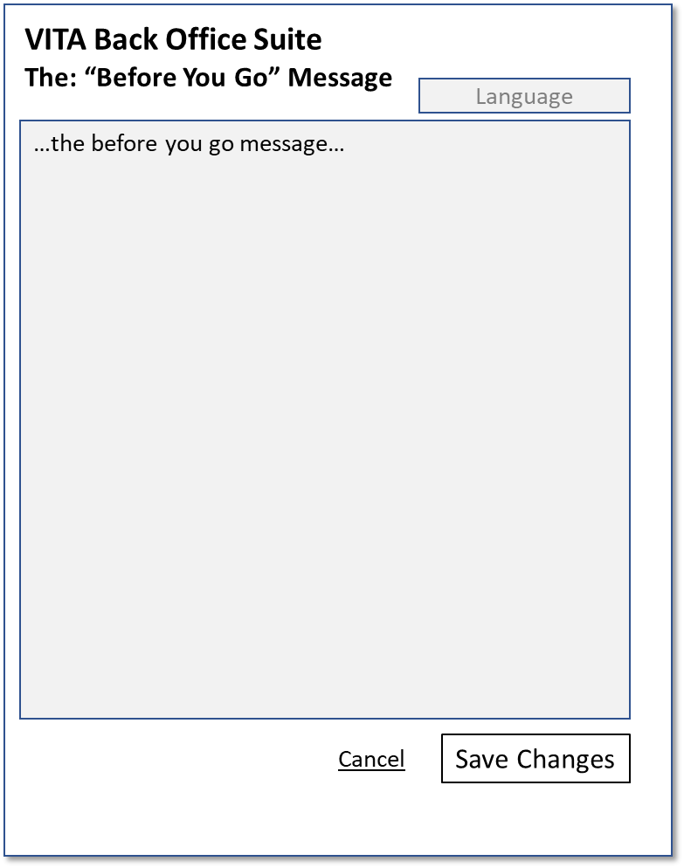
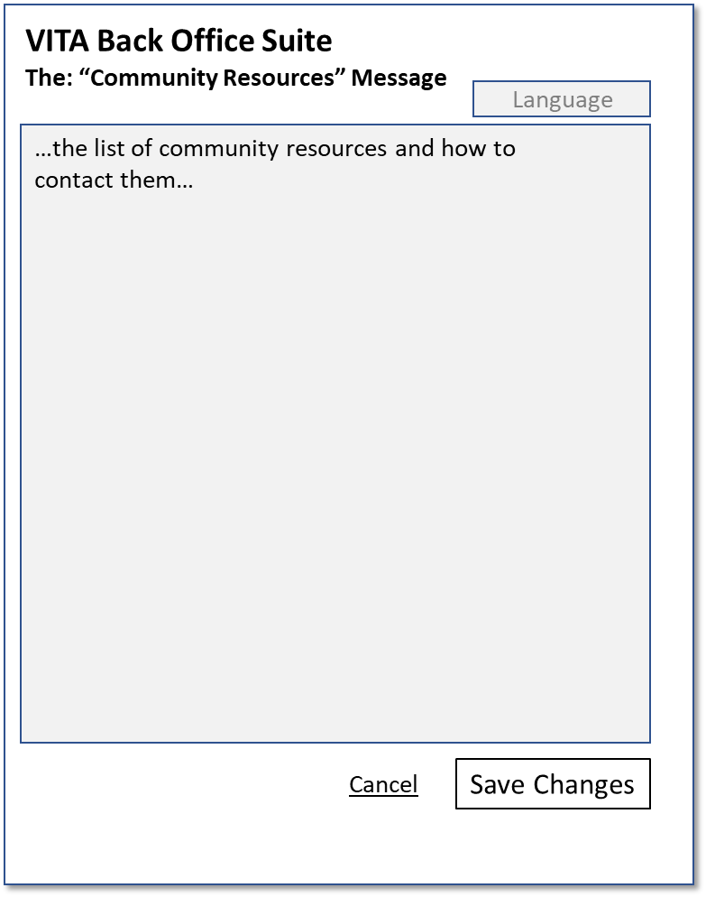
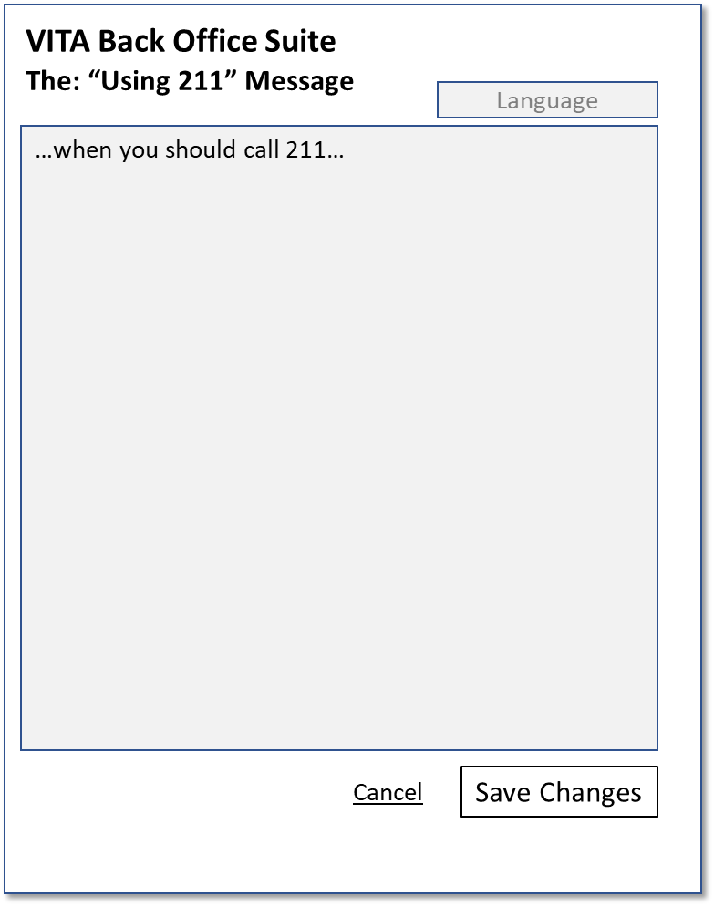
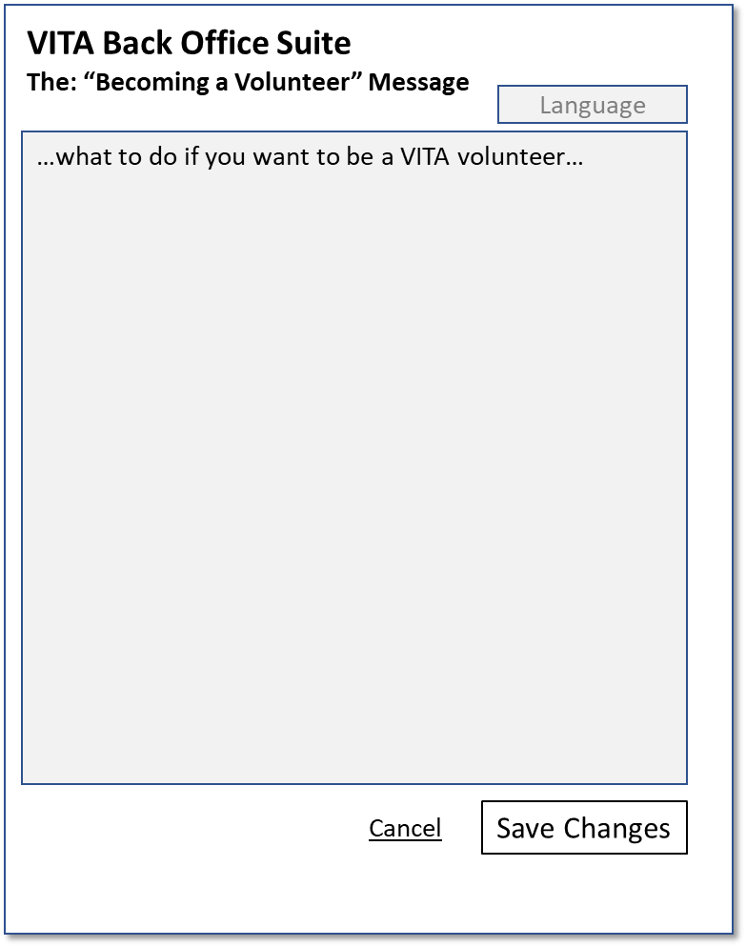
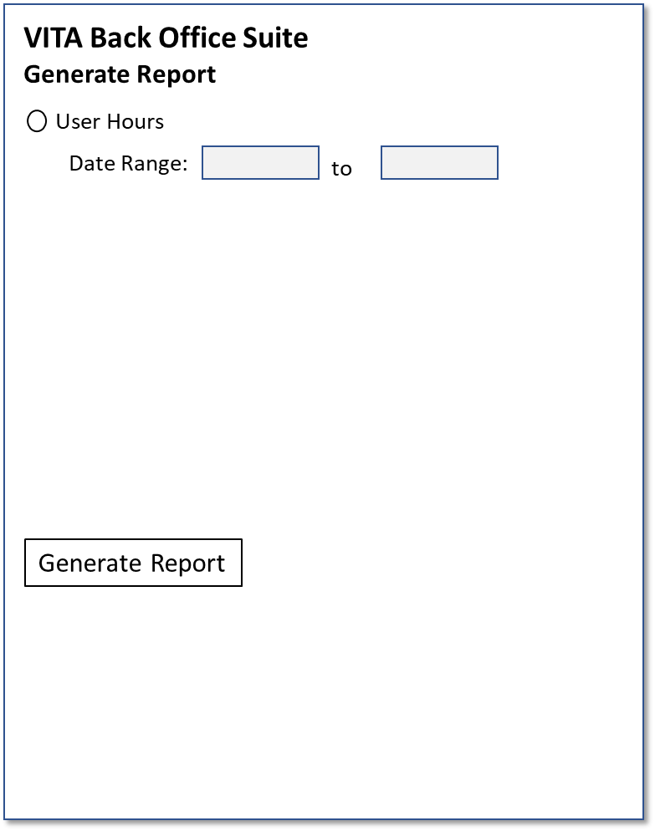

Slide 35
Login
Allow User to login
User must have role of BackOffice
Volunteers and Site Coordinators are not allowed to use the Site
Login
Success -> Action page
Failure – message and stay on Login
API
(#1.1) Login User
VITA Back Office Suite
This site is for Back Office and administrative staff working on the VITA San Antonio service. Only authorize staff are allowed to access this site.
Email:
Password:
Login

Slide 36
Action
VITA Back Office Suite
Logout
Dashboard
Site Status
Volunteer Status
Dashboard updates every minute or so
Links to key tools
Create A Site -> Site Management with blank template
View Pending -> Users Management with Pending filter
Edit/Remove User -> Users Management with no filter
Post a bug report -> Github issues for this project (new tab)
API
(#4.1) Get Site Details (all Sites)
(#2.1) Get SignUps (today, all Sites, all Users)
#
Sites
#
Signed Up
#
Open
#
Needed
#
Near Limit
Top Site Shortages
#
At Limit
Site 1
#
Closed
Site 2
Site 3
Site 4
Site Management
Resources
Create new Site
Edit: Before you go
Sites List
Edit: Community Resources
Send Notification
Edit: Using 211
User Management
Edit: Becoming a Volunteer
View Pending Registrations
All Users
Clients
Edit/Remove User
View Client Feedback
Reporting
Post a Bug Report
Generate Volunteer Report

Slide 37
Sites Management
VITA Back Office Suite
Sites List
New Site
Status
Vol
Site Name
List of all Sites
Click on header to sort
Click on Site -> Site Management
API
(#4.1) Get Site Details (all Sites)
(#2.1) Get SignUps (today, all Sites, all Users)
Accepting
5/7
Guadalupe Community Center

Slide 38
Site Editor
VITA Back Office Suite
Site Editor
Site (English):
Details of a Site in a form for editing
Save Changes sends the update to the DB
Remove This Site issues a prompt with a warning
Cleans up Calendar, SignUps, etc.
Save on new causes a Create
API
(#4.1) Get Site Details (this Site)
(#4.4) Update Site Details
Site (Spanish):
Current Site Client Status:
Closed
Make Client Status: Accepting Near Limit At Limit Closed
Site Coordinator:
Drop down list
Standard Days and Hours for Site
Sunday
Open Time:
Monday
Tuesday
Close Time:
Wednesday
Thursday
View Site Calendar
Friday
Saturday
Site Location:
Address:
City:
State:
Zip:
Place ID:
Latitude:
Longitude:
Remove This Site
Cancel
Save Changes

Slide 39
Notifications
VITA Back Office Suite
Notifications
New Notification
List of all Notifications
Sorted with newest at the top
Click on Notification -> Notification
Make a copy
Click on New Notification -> Notification
Create new blank
API
(#6.1) Get Notifications()
Valid
Target
Subject
2/7/2018 1700
nSUV
GCC urgently needs help

Slide 40
Notification
VITA Back Office Suite
Create and Send Notification
Create and Send a Notification
API
(Notification was sent with page)
(#6.2) Post Notification(Notification)
To:
Site Coordinators
Not Signed Up Volunteers
Signed Up Volunteers
Valid Until:
Date
Time
Subject:
Message:
Cancel
Send Notification

Slide 41
Users Pending Registration
VITA Back Office Suite
Pending User Registrations
List of all Pending User Registrations
Click on User -> User Management
API
(#1.4) Get Users(state = Pending)
Status
Roles
User Name
User Phone

Slide 42
Users All
VITA Back Office Suite
All Users
List of all Pending User Registrations
Click on User -> User Management
API
(#1.4) Get Users()
Status
Roles
User Name
User Phone

Slide 43
User Management
VITA Back Office Suite
User Editor
User Name:
Details of a User in a form for editing
Save Changes sends the update to the DB
Remove This User issues a prompt with a warning
Cleans up: SignUps, etc.
Certification Level: Basic, Advanced, Site Coordinator
Site Coordinator at: list of Sites
API
(#4.1) GetSites (all)
(#1.4) GetUser(username)
(#1.5) Update User (User)
(#1.6) Remove User(User)
User email:
User Phone:
Certification Level:
Drop Down List
User Role:
Volunteer
Site Coordinator
Back Office
Site Coordinator at:
Drop Down List
Drop Down List
Drop Down List
Remove This User
Cancel
Save Changes

Slide 44
Client Feedback
VITA Back Office Suite
Client Feedback
List of all Client Feedback (aka Suggestions)
Sort with most recent first
Click on Feedback -< Client Feedback Item
API
(#1.4) Get Suggestions
Date
Feedback

Slide 45
Client Feedback Item
VITA Back Office Suite
View Client Feedback
Create and Send a Notification
?log the sending?
API
(#5.1) Get Suggestions flagged as Client Feedback
Subject:
Message:
Done

Slide 46
Edit Message: Before You Go Message
VITA Back Office Suite
The: “Before You Go” Message
Language
View/Edit the “Before you go” message
API
(#7.1) Get Message(beforeYouGo)
(#7.2) Set Message(beforeYouGo)
…the before you go message…
Cancel
Save Changes

Slide 47
Edit Message: Community Resources
VITA Back Office Suite
The: “Community Resources” Message
Language
View/Edit the “Community Resources” message
API
(#7.1) Get Message(communityResources)
(#7.2) Set Message (communityResources)
…the list of community resources and how to contact them…
Cancel
Save Changes

Slide 48
Edit Message: Using 211
VITA Back Office Suite
The: “Using 211” Message
Language
View/Edit the “Using 211” message
API
(#7.1) Get Message(using211)
(#7.2) Set Message(using211)
…when you should call 211…
Cancel
Save Changes

Slide 49
Edit Message: Becoming a Volunteer
VITA Back Office Suite
The: “Becoming a Volunteer” Message
Language
View/Edit the “Becoming a Volunteer” message
API
(#7.1) Get Message(becomingAVolunteer)
(#7.2) Set Message(becomingAVolunteer)
…what to do if you want to be a VITA volunteer…
Cancel
Save Changes

Slide 50
Generate Report
VITA Back Office Suite
Generate Report
User Hours
Generate User Hours report
(this still needs work)
API
(#2.1) Get Sign Ups(date range)
Date Range:
to
Generate Report

Slide 51
API

Slide 52
Consolidated API
* - could be null, all, single item, or list
User Login
Login (email, password) -> token, User Role
Logout(token)
Register new user (details) -> status code
GetUser(token, users*, state*) -> List of Users
UpdateUser(token, User) -> status code
RemoveUser(token, User) -> status code
SignUps
Get SignUps(token, user*, site*, date range*) -> List of signups
Add SignUp(token, User, Site, Date, SignUp)
Remove SignUp(token, User, Site, Date, SignUp)
Update SignUp(token, User, Site, Date, SignUp)
Update SignUps(token, User, Site, Date, List of SignUps)
Site Calendar
Get Site Calendar (token, site*, date range*) -> default calendar, List of exceptions
Update Site Calendar(token, Site, Date, Calendar)
Site Details (includes Client Status)
Get Site Details (site*) -> Site details
Set Site Details(token, Site) -> status code
Get Sites with Site Coordinator(token, User) -> List of Sites
Update Site Details(token, Site) -> status code
Suggestions
Get Suggestions (token, user*, suggestion status*, date range*, count*, type*) -> list of suggestions
Add Suggestion(token*, user*, Suggestion) -> status code
Remove Suggestion(token, User, Suggestion) -> status code
Update Suggestion(token, User, Suggestion) -> status code
Notifications
Get Notifications(token, since date) -> List of current notifications
Post Notification(token, Notification) -> status code
Messages
GetMessage(type) -> Message
SetMessage(type) -> status code

Slide 53
Models
User Roles: Volunteer, SiteCoordinator, BackOffice
Notification: Subject, Body, Valid Until, TargetOfNotification
TargetOfNotification: Site Coordinators, SignedUpVol, !SignedUpVol, All
Suggestions: Type (Vol, Client), From, Subject, Body, Status
User: Name, email, phone, cert level, roles, sites
SignUp: User, Site, Date, Hours, approved

Slide 54
Notes/Thoughts/Nightmares/Stuff…
Lost password process?
Volunteer sign-up that is completed and has been approved hours is locked (cannot be edited or deleted)
If close a Site with Volunteers, remove their sign up?
How Volunteer see summary of their hours?
How to know version of API?
How to know service is offline?
Logging: all BackOffice actions, Site Coordinators?, Volunteers?

